Slide 1
Global Superstore Sales Analysis By Isaac Mbagwu
Analyzing Sales, Profitability & Logistics Performance

Slide 2
Content:
Dataset: Global Superstore
Tools Used: Excel, Power Query, Power Pivot
Records analyzed: ~5M orders
Scope: Sales, Profit, Shipping, Regional performance

Slide 3
Business Objectives
Analyze overall sales performance
Evaluate profit across categories
Assess shipping cost impact on profitability
Identify top-performing regions & products
Examine sales trends over time

Slide 4
Data Preparation
Data cleaning in Power Query
Removed duplicates & nulls
Created tables (Customers, Products, Location and Calander)
Built relationships
Created measures (Sales, Profit and Margin)

Slide 5
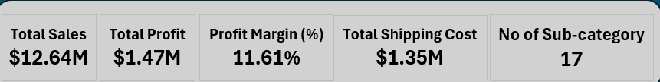
KPI Summary
The company generated $12.64M in sales with an 11.61% profit margin.

Slide 6
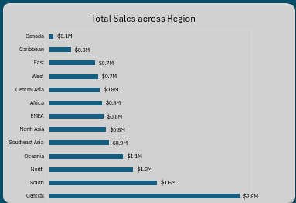
Sales Performance Analysis

Slide 7
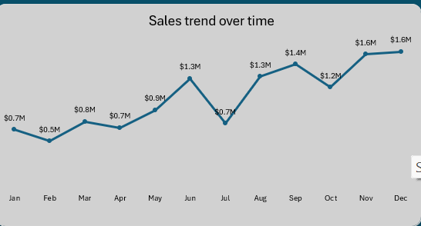

Slide 8
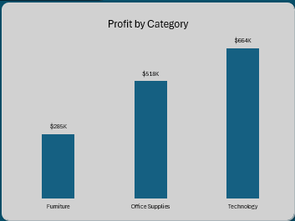
Profitability Analysis
Technology is most profitable
Furniture lowest margin

Slide 9
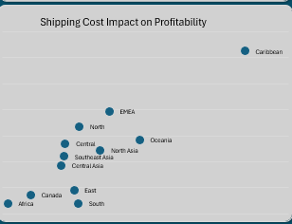
Shipping & Logistics Analysis
Logistics cost closely tied to profit

Slide 10
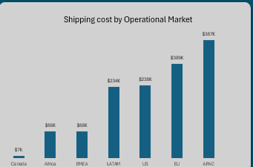
High shipping markets reduce profitability

Slide 11
Key Insights
Technology drives most profit
APAC has highest shipping cost
Q4 has peak sales
Some sub-categories underperform
Shipping cost impacts margins

Slide 12
Recommendations
Optimize shipping routes
Review discount strategies
Invest in high-profit categories
Reduce loss-making products
Strengthening strong markets

